Slide 1
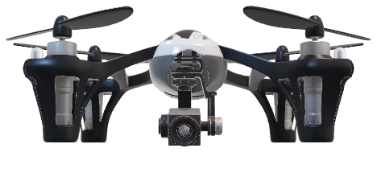
Milestone I Presentation
FPGA for Machine Learning on a Drone

Slide 2
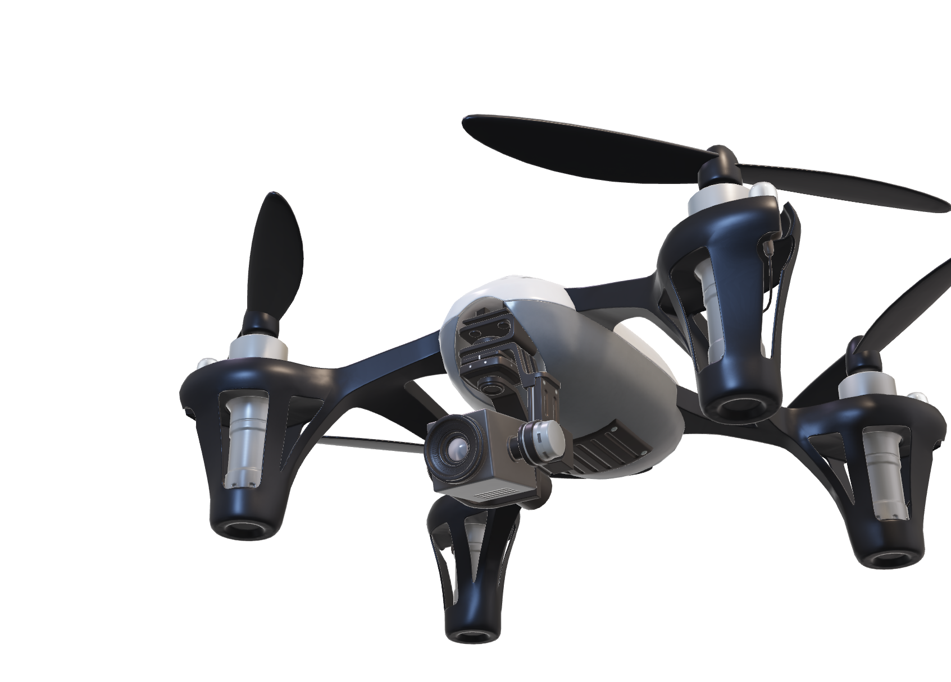
Presentation Overview
Context and Purpose
Requirements
Constraints
Risks
Risk Mitigation
Viability of the Project
Solution Path

Slide 3
Why
?

Slide 4


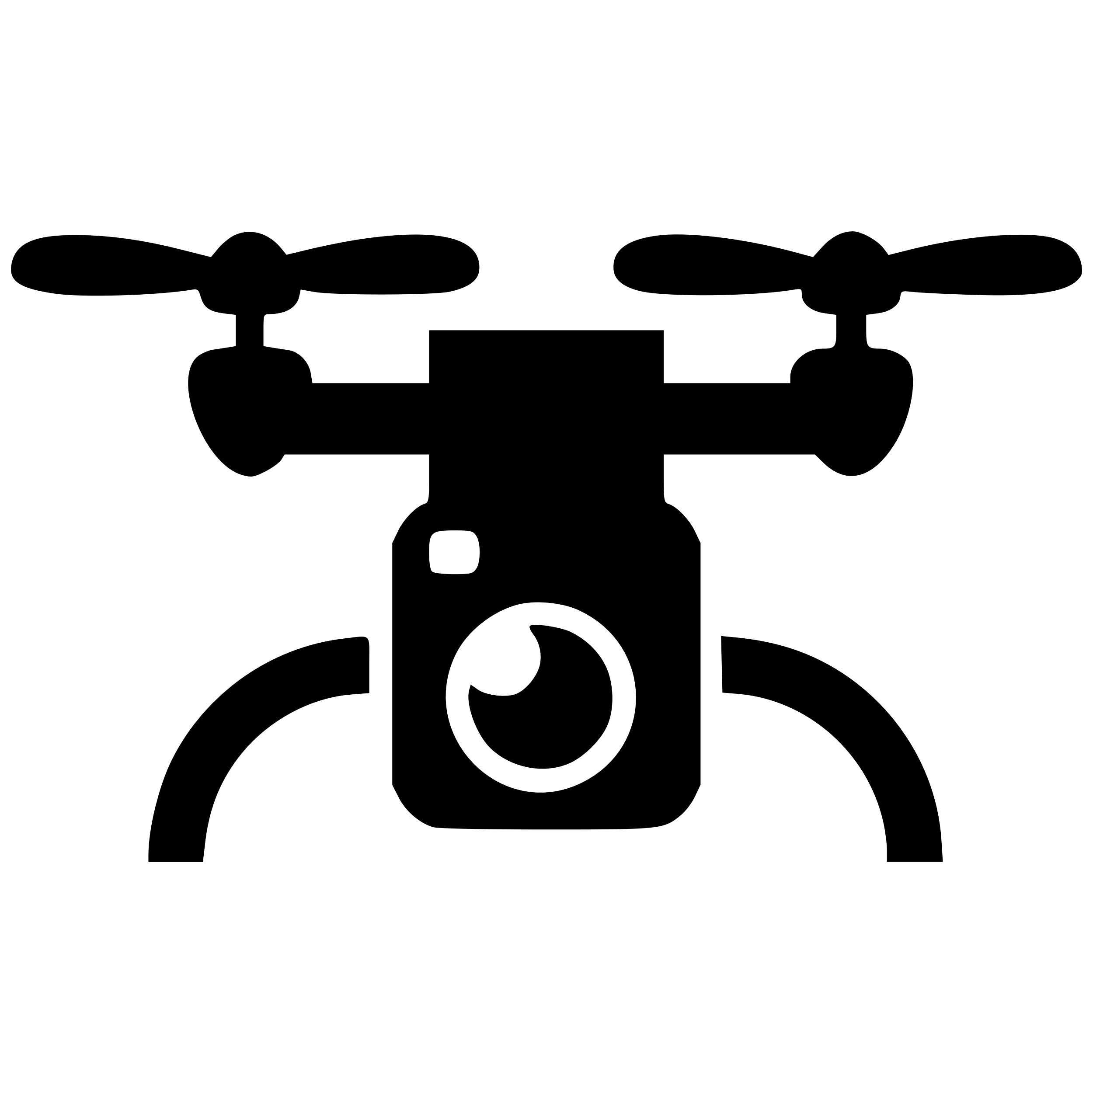
Context & Purpose
Increasing machine learning and drone applications
No existing combination of FPGA + ML + drone on the market
FPGA

Slide 5

Context & Purpose
Want to combine all of them → computing platform
Accelerate ML using FPGA
FPGA on deployed on the drone
Communicate with ground station
Detect pedestrians from above
For client’s research in ML
FPGA

Slide 6
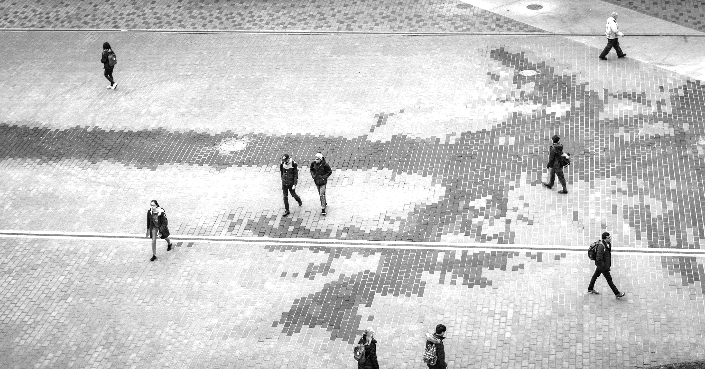
detecton_00 confidence: 0.95 err: 0.08
detecton_04 confidence: 0.95 err: 0.16
detecton_07 confidence: 0.92 err: 0.11
detecton_03 confidence: 0.88 err: 0.06
detecton_06 confidence: 0. 1 err: 0.09
detecton_02 confidence: 0.99 err: 0.11
detecton_01 confidence: 0.99 err: 0.06
detecton_17 confidence: 0.57 err: 0.21
detecton_16 confidence: 0.65 err: 0.23

Slide 7
Requirements
&
Constraints

Slide 8
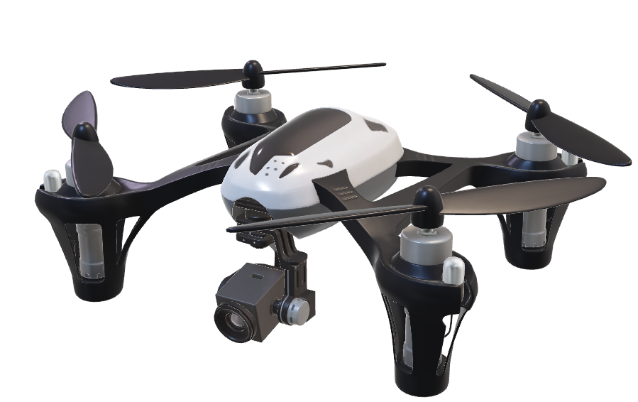
Requirements
Integrated Drone Requirements
Capable of flying with the computing platform
Flight duration at least 10 minutes
Remote controlled by the pilot
FPGA hardware acceleration

Slide 9
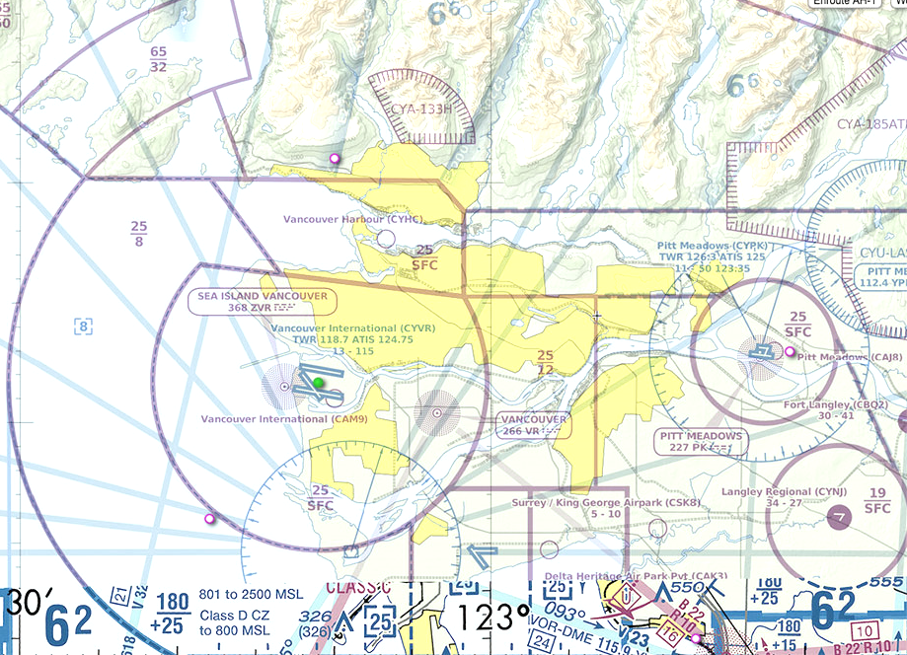

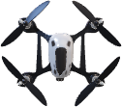
Requirements
Drone Legal Requirements
Operation is compliant with Transport Canada
Tests inside YVR controlled airspace is permitted

Slide 10

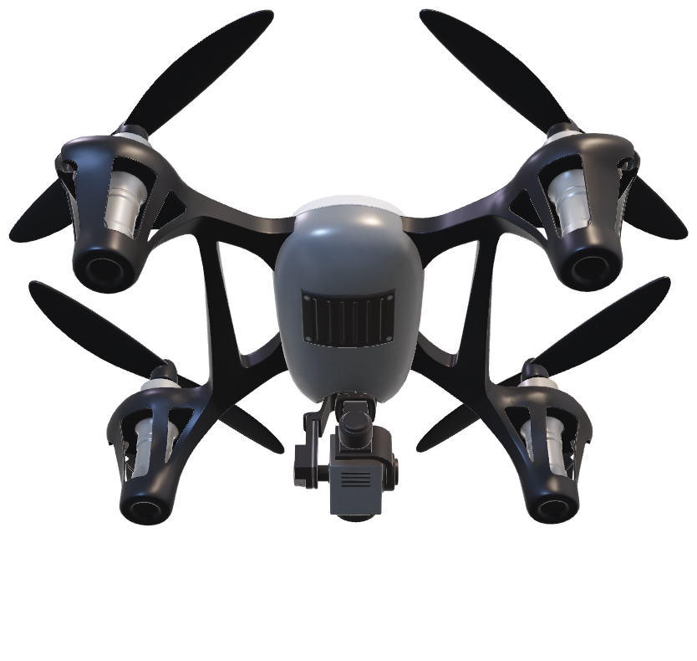
Requirements
Data Transmission Requirements
Data processed on the drone transmitted to ground station
Ground station receives and display data to the operator
Transmission via WiFi (2.4GHz or 5.2GHz)
Machine Learning Requirements
Machine learning model fits on FPGA
Model detects pedestrians and outputs bounding boxes

Slide 11
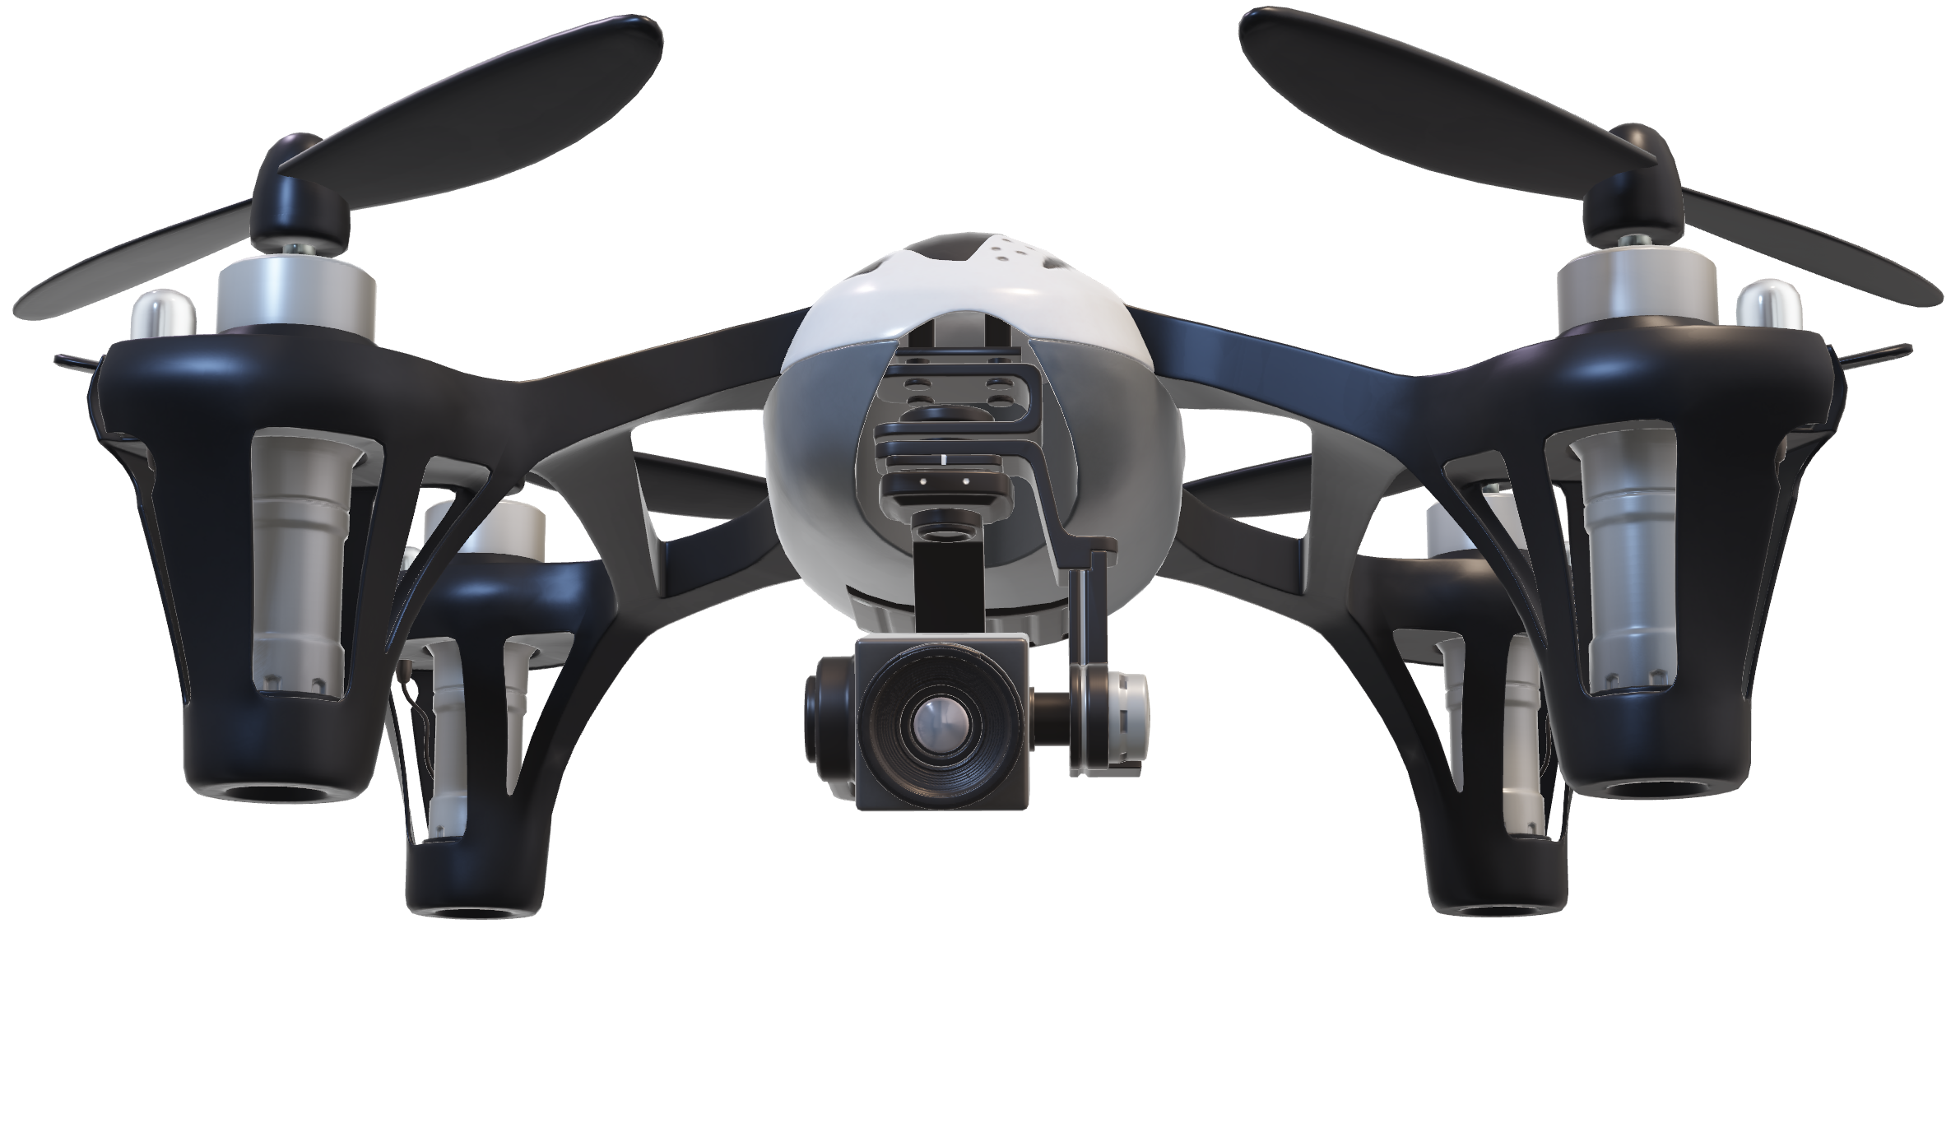
Requirements
Data Transmission Requirements
Data processed on the drone transmitted to ground station
Ground station receives and display data to the operator
Transmission via WiFi (2.4GHz or 5.2GHz)
Machine Learning Requirements
Machine learning model fits on FPGA
Model detects pedestrians and outputs bounding boxes

Slide 12
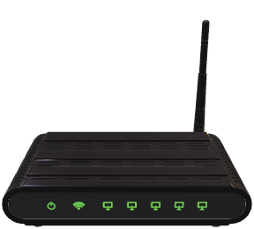

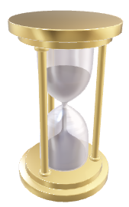

Constraints
Time & Budget
Future-Proofing
Power & Weight
Data Transmission
Limited to C$1,000
Limited time to perform 2 sub-projects
Coordination and leadership is challenging
FPGA big enough for future ML models
Battery power is limited
Weight and power draw affects flight duration
Portability
Limited bandwidth for data
Limited power emission
Limited range

Slide 13
Risks?

Slide 14




Risks
Hardware
Management
Legacy
Software
Flight crashes
Loss of FPGA
Loss of drone
Insufficient commitment
Poor task management
Poor decision making
Low repairability / maintainability
Client doesn’t know how to operate
Tech. debt
Inadequate documentation

Slide 15
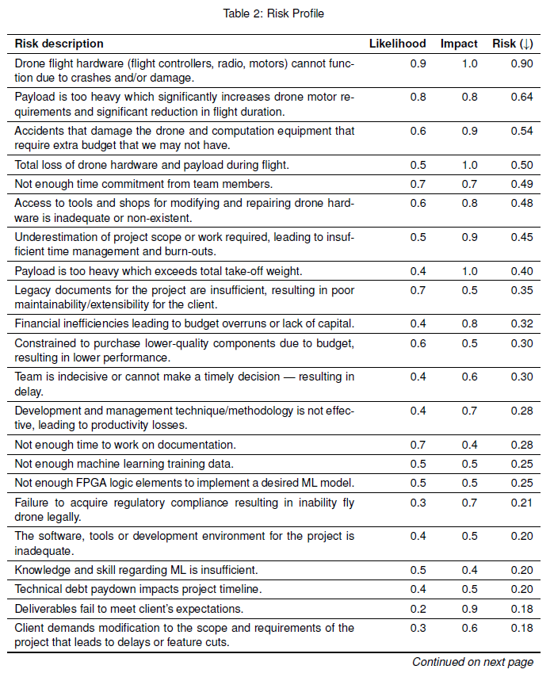
Risk Management
We keep track of an updated copy of the risk profile
Active mitigation on risks with index ≥ 0.4
Triage tasks to mitigate risk
Weekly update on risk status
Active monitoring on risks with index < 0.4

Slide 16

Risk Management
Hardware
Management
Legacy
Software
Follow safety protocol
Weekly updates and status report on assigned tasks
Timeline closely tracked
Actively updating all documents alongside changes
Version tracking
Code review

Slide 17
Viable?

Slide 18
Viability
Assess system feasibility on 3 objectives:
1
2
3
Integration of FPGA with a Drone
Air-to-Ground Data Transmission
ML Implementation on FPGA

Slide 19
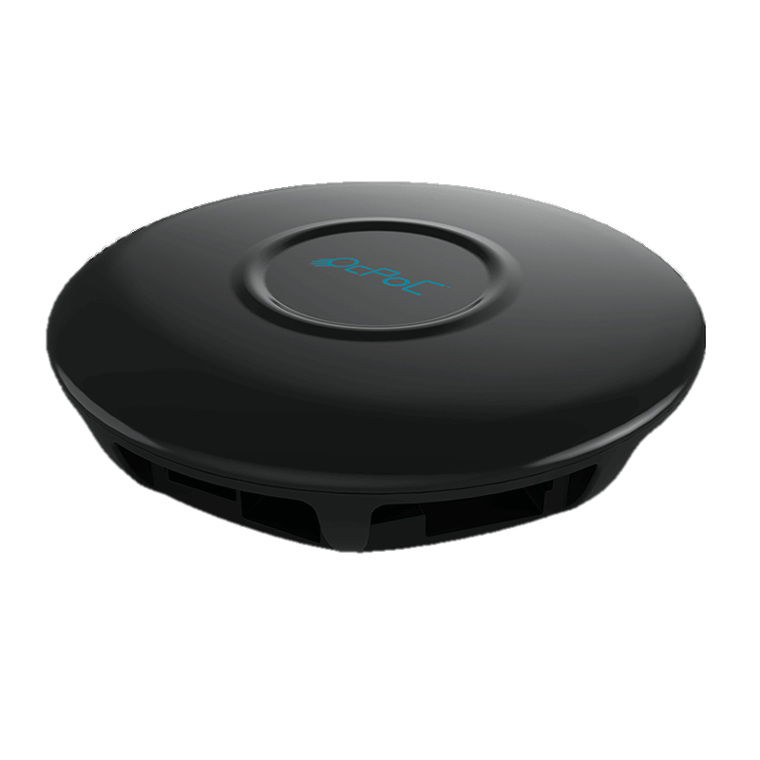
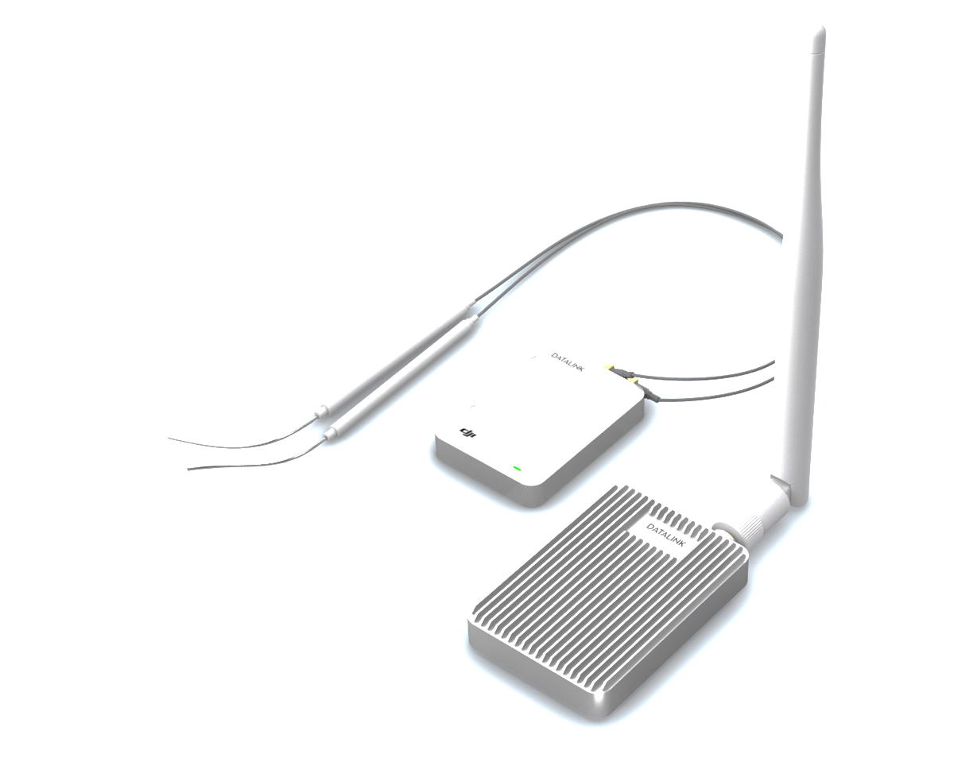

Viability
All three objectives individually has existing solutions
1
2
3
Integration of FPGA with a Drone
Air-to-Ground Data Transmission
ML Implementation on FPGA
Aerotenna FPGA flight controller
SymbioticEDA MARLANN
DJI DATALINK

Slide 20
Viability
All three objectives individually exists as existing solutions
1
Integration of FPGA and camera with a Drone
Aerotenna FPGA flight controller
2
Air-to-Ground Data Transmission
3
ML Implementation on FPGA
DJI DATALINK
MARLANN

Slide 21
Viability
Combination of the three will further this field of research
This project is a proof-of-concept

Slide 22
Solution?

Slide 23
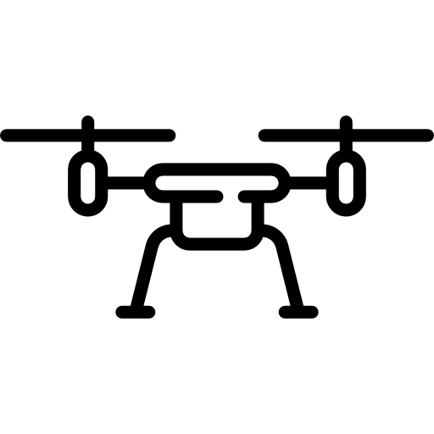





Deliverables
FPGA 🖤 ML
1x
1x
1x
5x

Slide 24
Deliverable Dates
Feb 10
Second Prototype
Drone, control, data transmission
Power systems
Intermediate ML
2019
2020
Nov 25
First Prototype
April 3
Final Product Delivery
Initial ML demo
Video capture from drone

Slide 25



Immediate Steps
Start Small
Start Quickly
Start Legally
Function over scale
Integrate existing model
Create purchasing plans
Tool setup takes time
Drone registration
Pilot and radio certifications

Slide 26
Q?

Slide 27
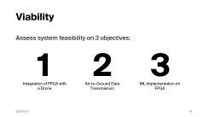
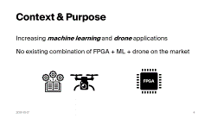
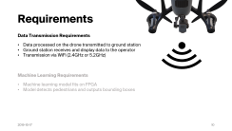
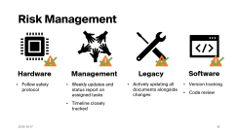
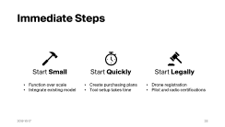
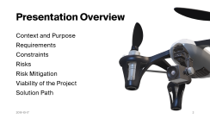
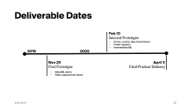
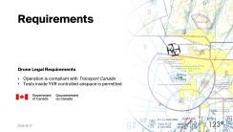
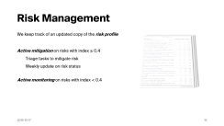
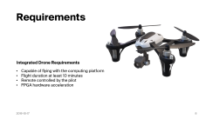
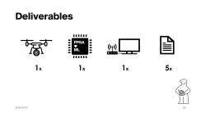
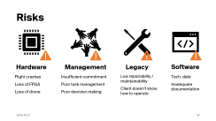
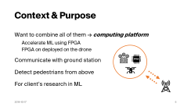
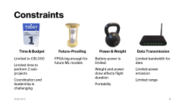
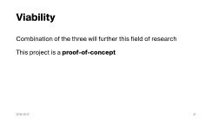
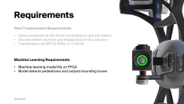
Q?

Slide 28
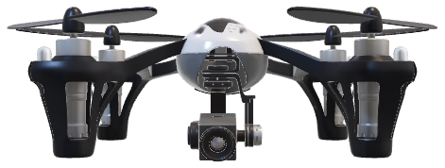
Thanks For Listening: Milestone I Presentation
FPGA for Machine Learning on a Drone

